Slide 1
WAN Technologies and Routing

Slide 2
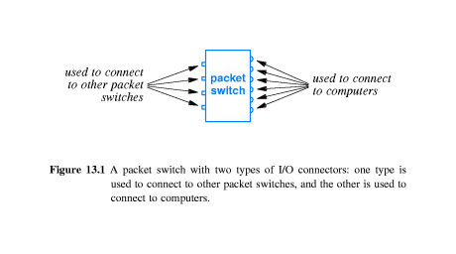
Packet Switch

Slide 3
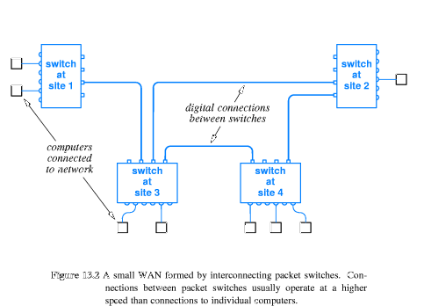
Sample WAN

Slide 4
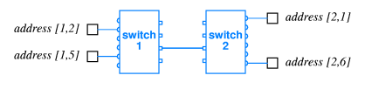
Physical Addressing

Slide 5
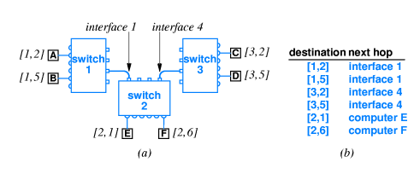
Next-Hop Forwarding
Routing Table on Switch 2

Slide 6
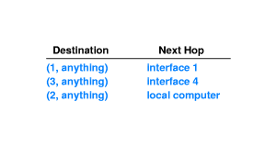
Route Summarization

Slide 7
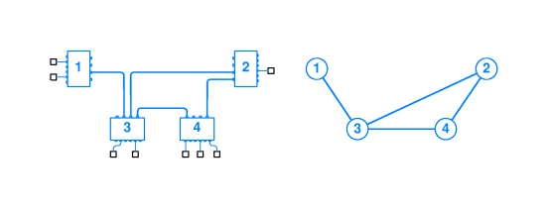
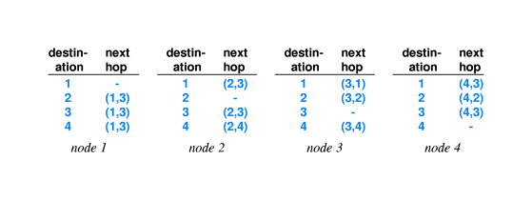
Routing Example

Slide 8
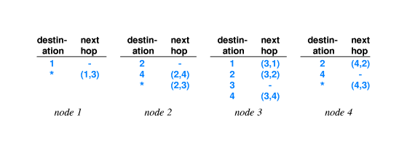
Use of Default Routes

Slide 9
Routing Table Computation
Static Routing: A program computes and installs routes when a packet switch boots; the routes do not change.
Dynamic Routing: A program builds an initial routing table when a packet switch boots; the program then alters the table as conditions in the network change.

Slide 10
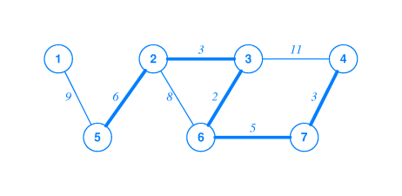
Shortest Path Computation

Slide 11
Distributed Route Computation
Each packet switch computes its routing table locally.
It sends messages across the network to neighbouring packet switches to inform them of the result.

Slide 12
Link-State Routing
Each message sent by packet switches includes status of the link between two packet switches.
Each message is broadcast to all switches.
Each switch collects incoming status messages and build a graph of the network.
The switch uses Shortest Path Algorithm to build the routing table.

Slide 13
Distance Vector Routing
Each link in the network has a weight.
Distance to the destination is defined to be the sum of weights along the path to the destination.
An additional field “next hop” is included.
Each packet switch sends routing information across the network.
Each packet includes (destination, distance) pairs.

Slide 14
Distance Vector Protocols
IP Routing Information Protocol (RIP) Version 1 and 2
IP Interior Gateway Routing Protocol (IGRP)
Novell NetWare Internetwork Packet Exchange Routing Information Protocol (IPX RIP)
Apple Talk Routing Table Maintenance Protocol (RTMP)
Apple Talk Update-Based Routing Protocol (AURP)
IP enhanced IGRP (an advanced distance-vector protocol)
IP Border Gateway Protocol (BGP) (a path-vector routing protocol)

Slide 15
Link-State Routing Protocols
IP Open Shortest Path First (OSPF)
IP Intermediate System-to-Intermediate System (IS-IS)
NetWare Link Services Protocol (NLSP)

